Slide 1


AIDA GDPR-scanner
Identification and cleaning of
GDPR-sensitive content with AI
Marc Jacobs
+31657748895
Marc.Jacobs@azamiconsulting.nl
may 2023

Slide 2
Intro: Azami BV
IT-company (3 FTE + robot), Roermond, Netherlands, started in 2017
Focus on cyber privacy-protection, machine-learning, AI
In-house developed product: AIDA GDPR-scanner for housing-associations
Professional, customer-focused, continuous-improvement

Slide 3





















Customers of AIDA GDPR-scanner (all Dutch housing associations)
2023
2022
2021
2020
2019
(Shared directory)
(delta)
(DMS)
(full)

Slide 4
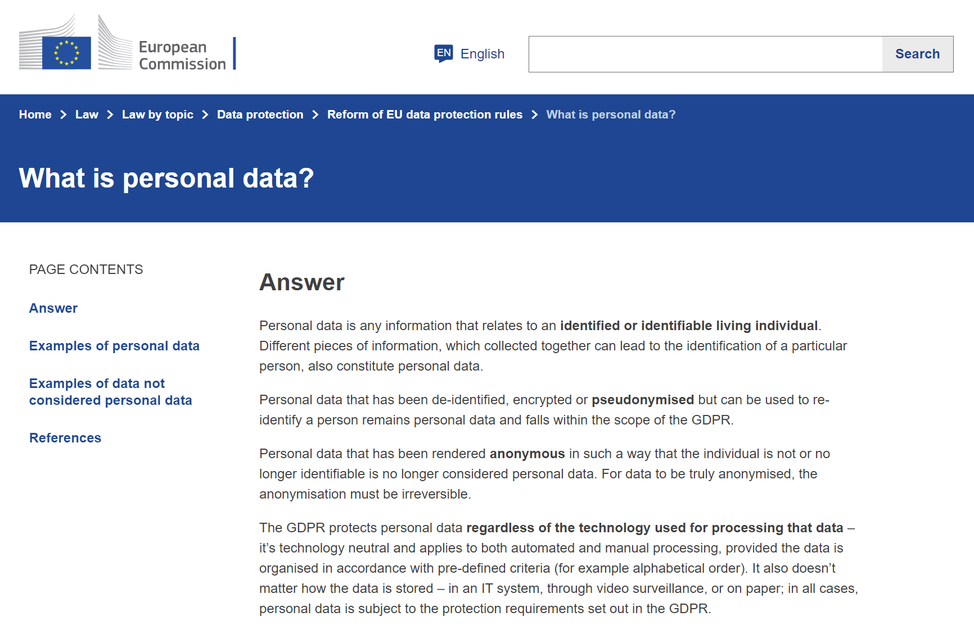
Customer data and personal data
Customer data
Organisations work with large amounts of customer data in systems and digital archives
Customer data: request forms, changes, income statement, passports and IDs
Doc-types: PDFs, Word, JPEG, Emails with attachments
A Dutch midsize housing association (15.000 houses) has approx. 500,000 customer documents: all communications with the customers of the last 10-15 years
Personal data
Any data that can be related back to a person
- copy passport or other ID
- social citizen number references in tax declaration form
- mentioning of nationality of customer
- income statement from tax authority
- reference to religion
- reference to health / medical situation
- letter from social support about problem situation in family
https://commission.europa.eu/law/law-topic/data-protection/reform/what-personal-data_en

Slide 5

GDPR and non-essential personal data
https://commission.europa.eu/law/law-topic/data-protection/reform/what-personal-data_en
European GDPR Legislation
Requires organisations to be careful with personal data.
Personal data that is non-essential for your business → remove, delete, make anonymous
Purpose of AIDA GDPR-scanner:
‘Identify and remove non-essential personal data’

Slide 6
How to protect personal data
Organisational measures
Internal processes, procedures: ‘In our house we shall never do the following …’
Trainings, audits, contracts: ‘In our house we follow the next rules …’
Technical measures
Firewalls, virus-scanner, encryption: ‘We keep the bad guys out of our house’
Removal of non-essential personal data: ‘We removed it ourselves, the bad guys cannot find this in our house’

Slide 7
AIDA approach: a GDPR data cleaning service
Completion
we hand-back the cleaned data-set and our end-report with actions done
Intake
we agree which data-set to clean,
and which GDPR categories
Cleaning
we replace & blank-out the GDPR content
Identification
we identify and report to you the GDPR sensitive content in the data-set
For continuous cleaning we can repeat each quarter or year (‘delta-load’)

Slide 8

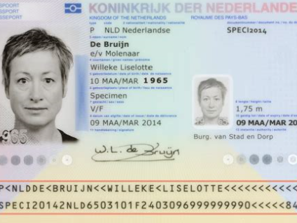


Flowchart of operational process
aaa
Apply medicine
aaa
ddd
katholiek
BSN
0456497
Apply medicine
positives
aaa
ccc
ddd
BSN
0456497
GDPR sensitivity algorithms
ddd
katholiek
aaa
aaa
negatives
aaa
ccc
aaa
aaa
Intake
Identification
Cleaning
Completion

Slide 9
When to use which algorithms?
 | ‘Traditional Intelligence’ | Artificial Intelligence
What do people say when asked how to recognise? | formulate (explain their logic) | ‘I just see it’ (cannot really explain)
Type of algorithm | coding: OCR, number logic, keywords, fuzzy-match | training: neural network, >50,000 examples of positives and negatives
Findrates | > 98% | >99%
How to improve further | better coding: OCR, handwriting recognition, pixel-distances | more training, more feedback-loops, machine-teaching

Slide 10
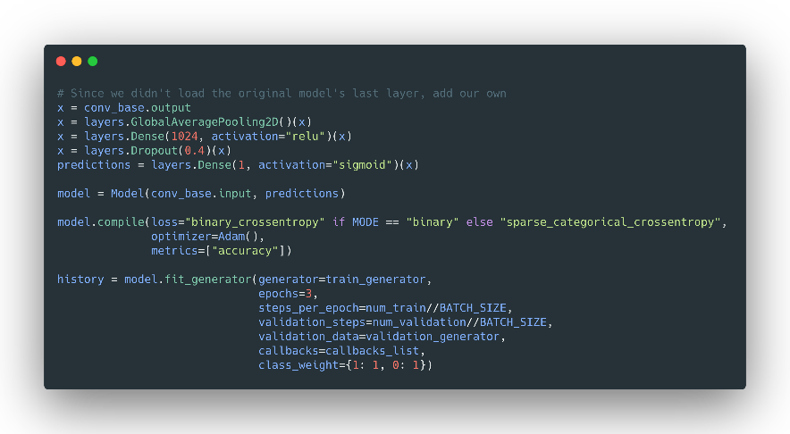
Artificial Intelligence: PIDs (passports, IDs, driving-licences)
Python code
Training:
50,000 PIDs
POSITIVES
(PID-score>270)
Neural network (‘brain’)
Training
100,000 non-PIDs
Likely
POSITIVES
(PID-score 200-270)
PID visual score
aaa
ccc
ddd
BSN
0456497
Likely
NEGATIVES
(PID-score 150-200)
PID word score
+
PID symbol score
NEGATIVES
(PID-score <150)

Slide 11
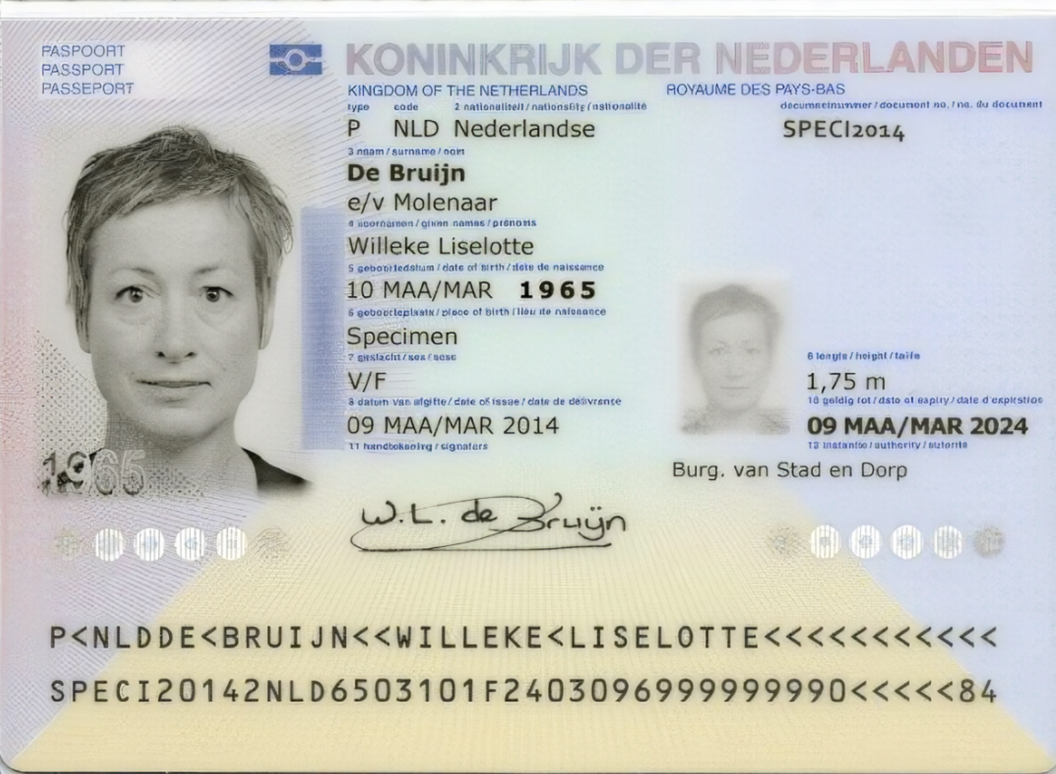
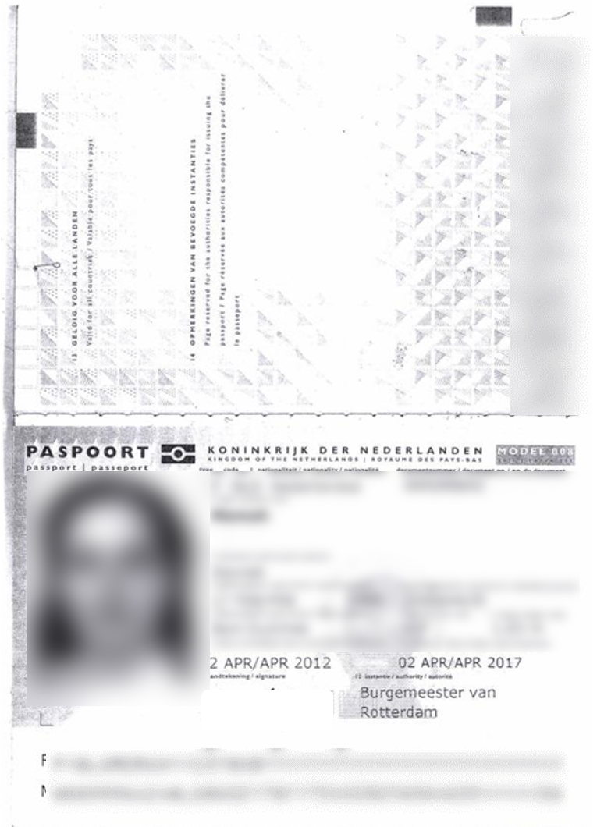
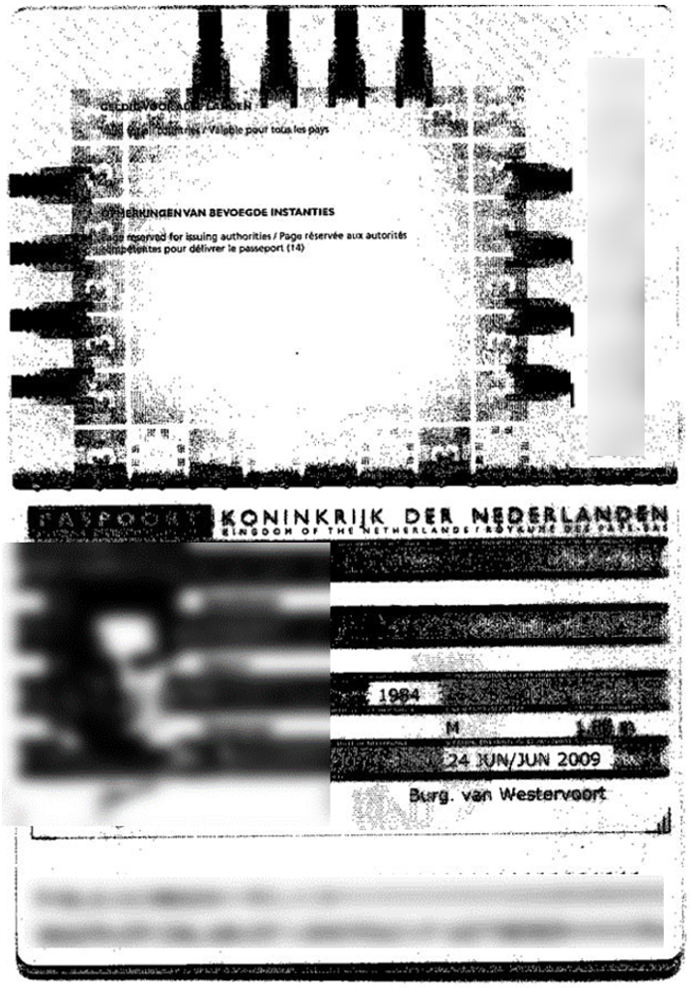
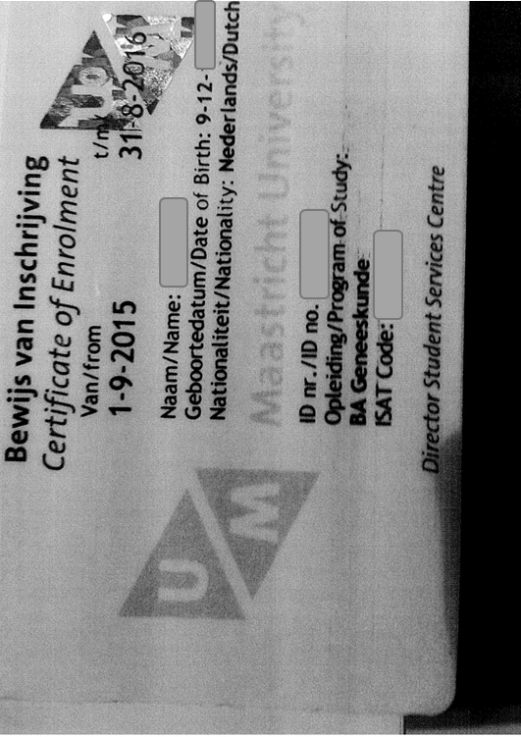


PID-score calculation
Specimen passport (Government provided)
Example 1
Example 2
Example 3
PID visual score 100 100 90 80
PID word score 100 95 60 40
PID symbol score 100 95 80 0
PID-score 300 290 230 120

Slide 12
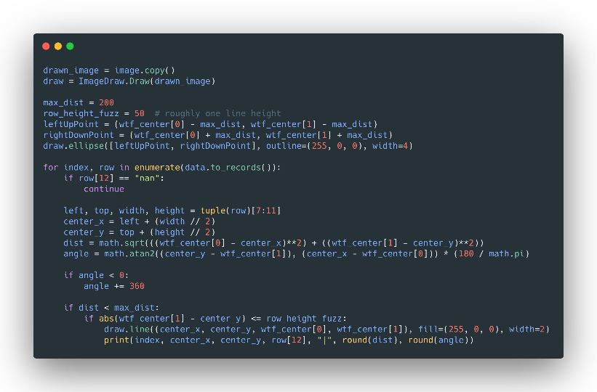
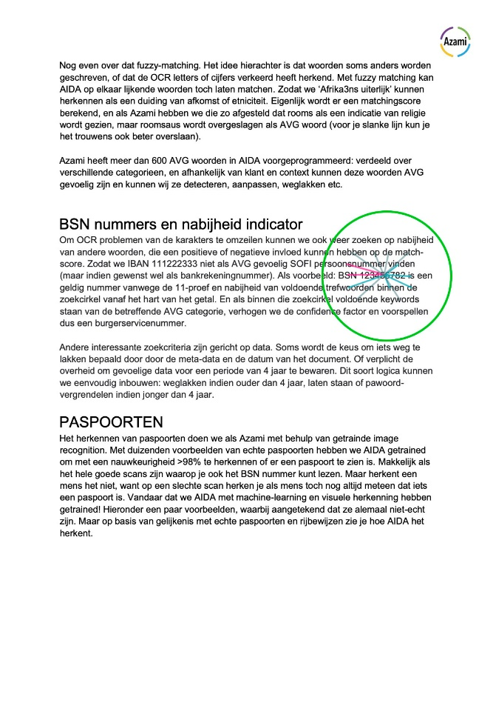
Traditional Intelligence: Social Citizen Numbers
Python code
Step 1: OCR, search, fuzzy match
Step 2: predict BSN-score based on 11-proof, keywords, pixel-distance, anti-keywords
Step 3: people to validate by BSN-score buckets

Slide 13
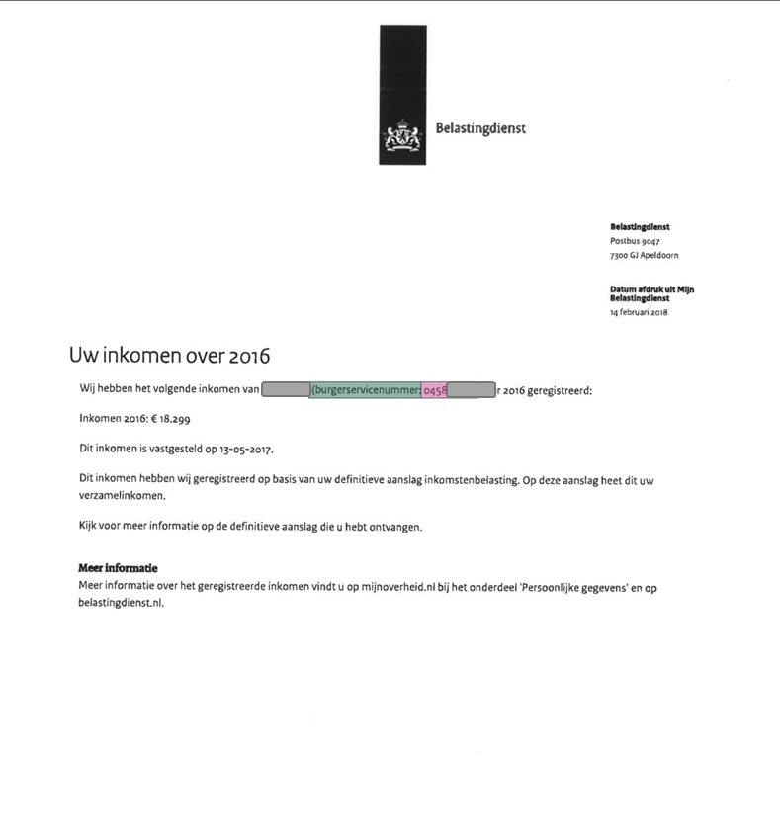
Example 1: BSN in Income statement from Dutch Tax Office
BSN
positive keyword

Slide 14
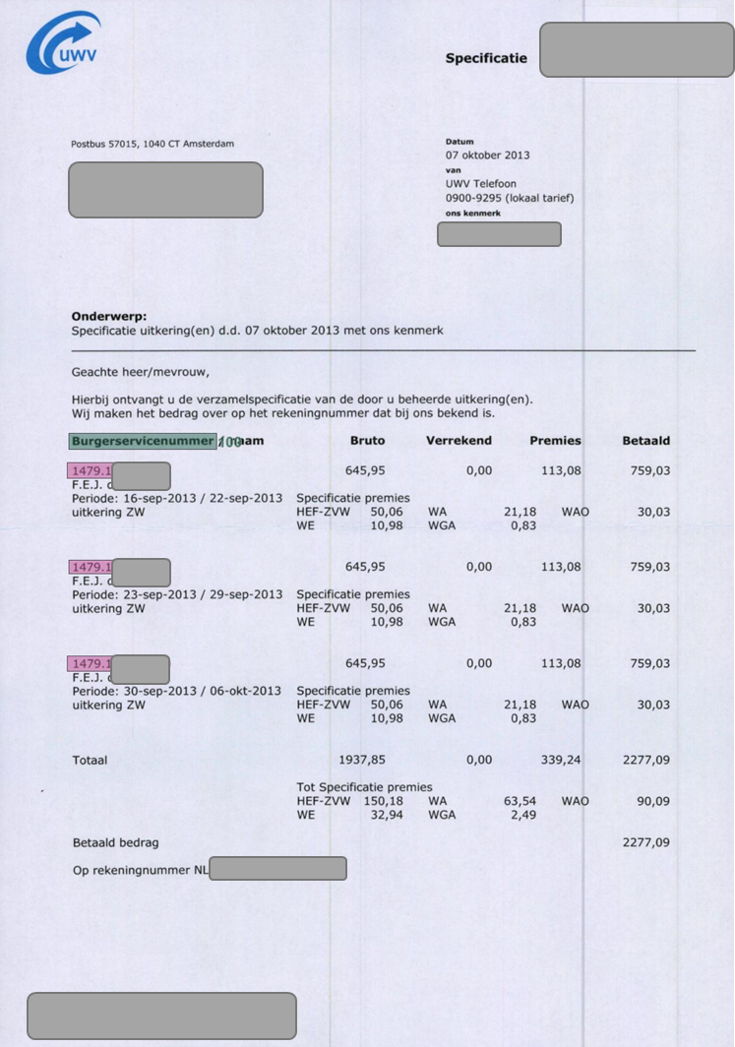
Example 2: BSN in benefit allowance specification
positive keyword
BSN

Slide 15
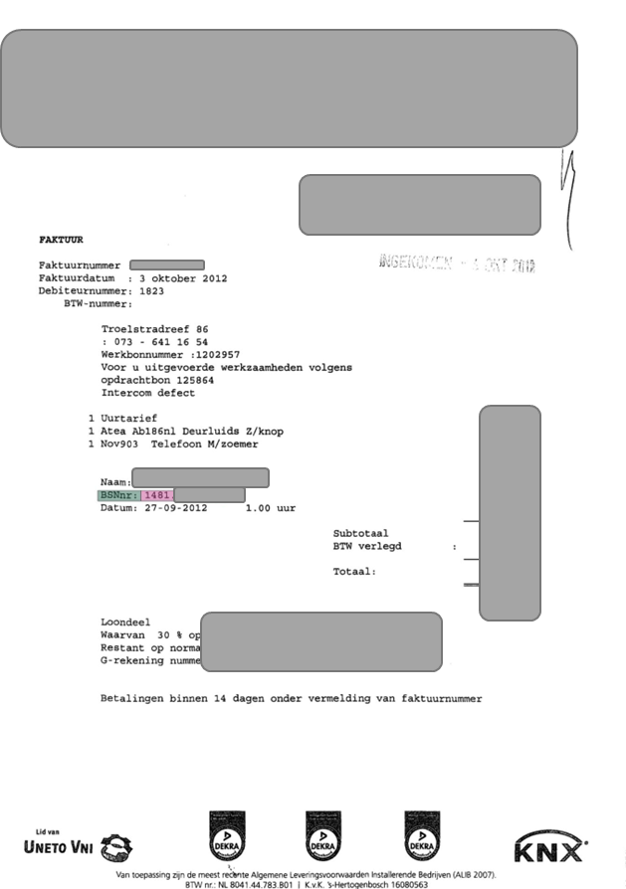
Example 3: BSN in supplier-invoice
positive keyword
BSN

Slide 16
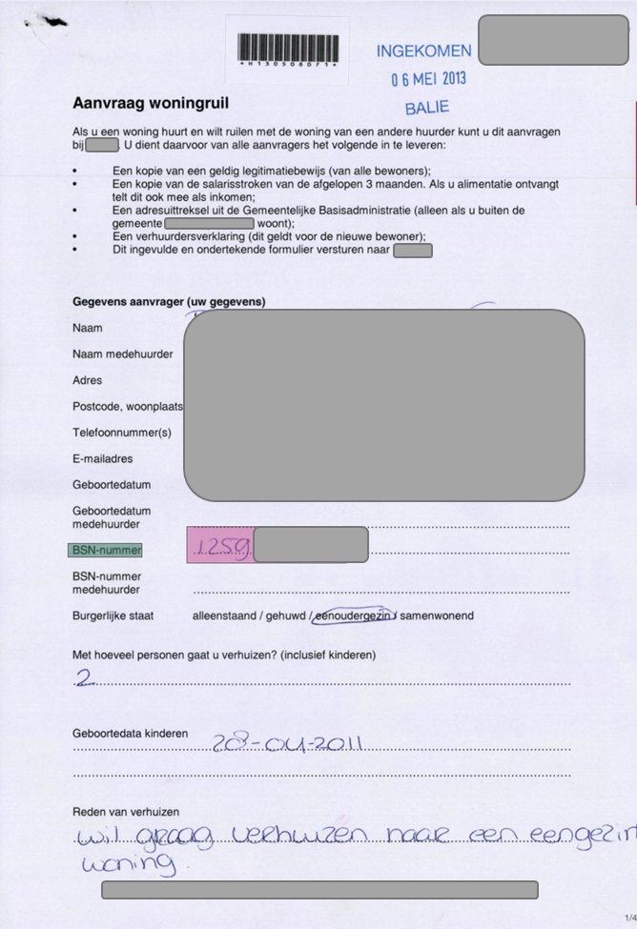
Example 4: handwritten BSN in customer-request form
positive keyword
Handwritten (!) BSN

Slide 17
Thuisvester results
Thuisvester: 2.1M documents
6.4M pages
Azure hosting platform
AIDA installed and runs on Thuisvester Azure

Slide 18
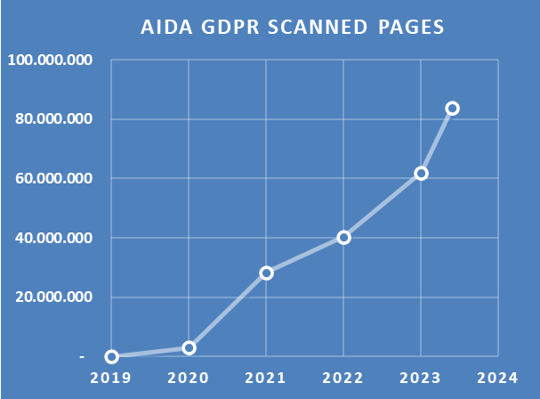

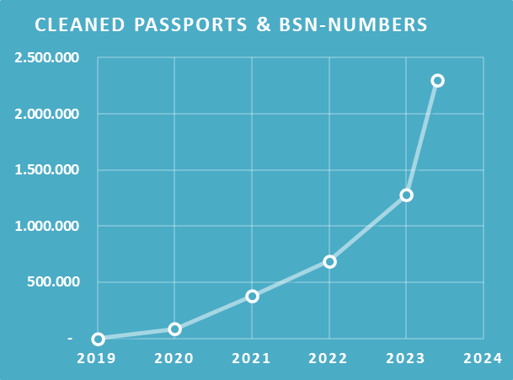
Azami-AIDA stats and scope-groups
Scope-group | GDPR content | Medicine
A – Personal data | passports, driving licenses, IDs | placeholder
 | BSN / SOFI numbers | blank-out
B – Income data | income statements, payslips, tax-declarations | placeholder
C - Special personal data | GDPR ethnic background | multiple choices
 | GDPR political preference | multiple choices
 | GDPR religion | multiple choices
 | GDPR trade union | multiple choices
 | GDPR health | multiple choices
 | GDPR sexual orientation | multiple choices
 | GDPR genetic data | multiple choices
 | GDPR biometrical data | multiple choices
 | GDPR criminal history | multiple choices
 | Urgency declarations | multiple choices
D – Custom-made | Customer-specific forms | multiple choices

Slide 19
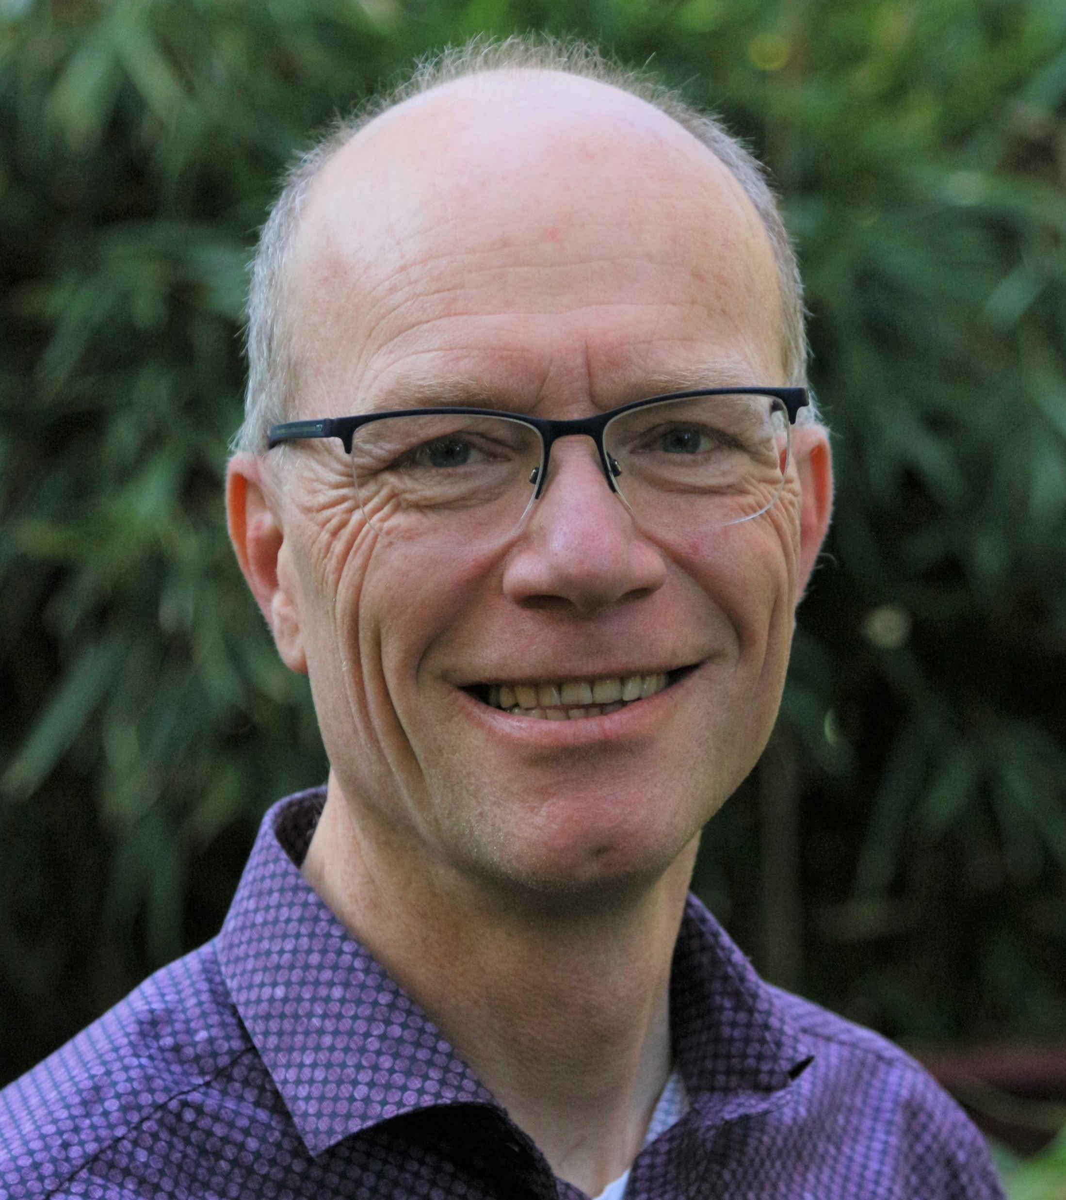

Marc Jacobs | Azami B.V.
Roermond, Nederland
M +31657748895 | marc.jacobs@azamiconsulting.nl
Website: www.azamiconsulting.nl
LinkedIn: www.linkedin.com/in/marc-jacobs-azami
CorpoNet KennisBite February 2021: Archief opschonen met AI(DA) - CorpoNet
Contact details

